Slide 1
MINI PROJECT - 1
SEMINAR ON ACADEMIC GURU (ONLINE STUDENT FORUM)

Slide 2

SHRI VISHNU ENGINEERING COLLEGE FOR WOMEN(A) (Approved by AICTE, Accredited by NBA & NAAC, Affiliated to JNTU Kakinada) BHIMAVARAM - 534202
DEPARTMENT OF COMPUTER SCIENCE AND ENGINEERING
Internal Guide
Mr. Y. RAMU M.Tech.,(Ph.D)
Associate Professor
Project Team Members
Paritala Umadevi – 18B01A05B0
Pudi Veekshita – 18B01A0580
Yasalapu Laasika – 18B01A0588
K. L. Prasanna – 19B05A0512
K. V. M. Madhuri – 19B05A0511

Slide 3
Abstract
Our project is an implementation of “ONLINE STUDENT FORUM” where ideas and doubts are exchanged and clarified respectively.
Our project’s main aim is to provide a separate Student Forum for our college students.
It is a Web application where users get registered and post queries or answer others questions.

Slide 4
Introduction
Students are facing much inconvenience to get their doubts clarified or to collect pre-requisites and get prepared.
There are many students who want to know the requirements to attend a workshop, tips or suggestions for exams, pre requirements for any training programs being conducted etc....
To clear the doubtful mind we came up with an Online Student Forum “ACADEMIC GURU” where students exchange doubts and clarify them.
Our users are both students and Faculty who need to register either to post question or to answer question.

Slide 5
The registered users can able to see all the questions posted by other users and answer them.
The questions posted are available in home page (which include questions of all categories).
In Menu the queries are divided based on categories (Workshops, Recruitment, Training programs, Subjects).
This project is only for academic purpose.

Slide 6

Existing System
“Student Edge” is an online platform for student affairs which also include a forum for student discussions.
Students in our college need to go to library or meet faculty to get their doubt clarified.
There may be times where faculty are not available.

Slide 7
Proposed System
We came up with an Online Student Forum to help our students in getting their doubts clarified.
Student at any point of time can post their question in the forum. This question is seen by all users in the forum and hence any one of them would answer the question.
This reduces student effort to go and meet faculty instead she can get direct clarification from that faculty or other students.

Slide 8
MODULES
Module 1: The user is provided with all the questions that are posted by other users. To answer she/he can click on Post Answer and answer the question. To see the answers she/he can click on Shoe Answers.
Module 2: The ask page allows the user to post her doubt
Module 3: The profile page allows user to see his profile information, if wanted he/she can make changes in it.

Slide 9
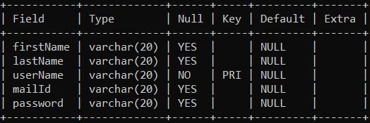
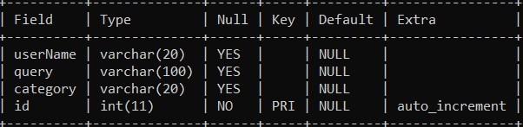
Database Tables
User data table
Questions table

Slide 10
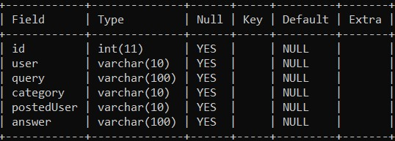
Database Tables
Posted Answers table

Slide 11
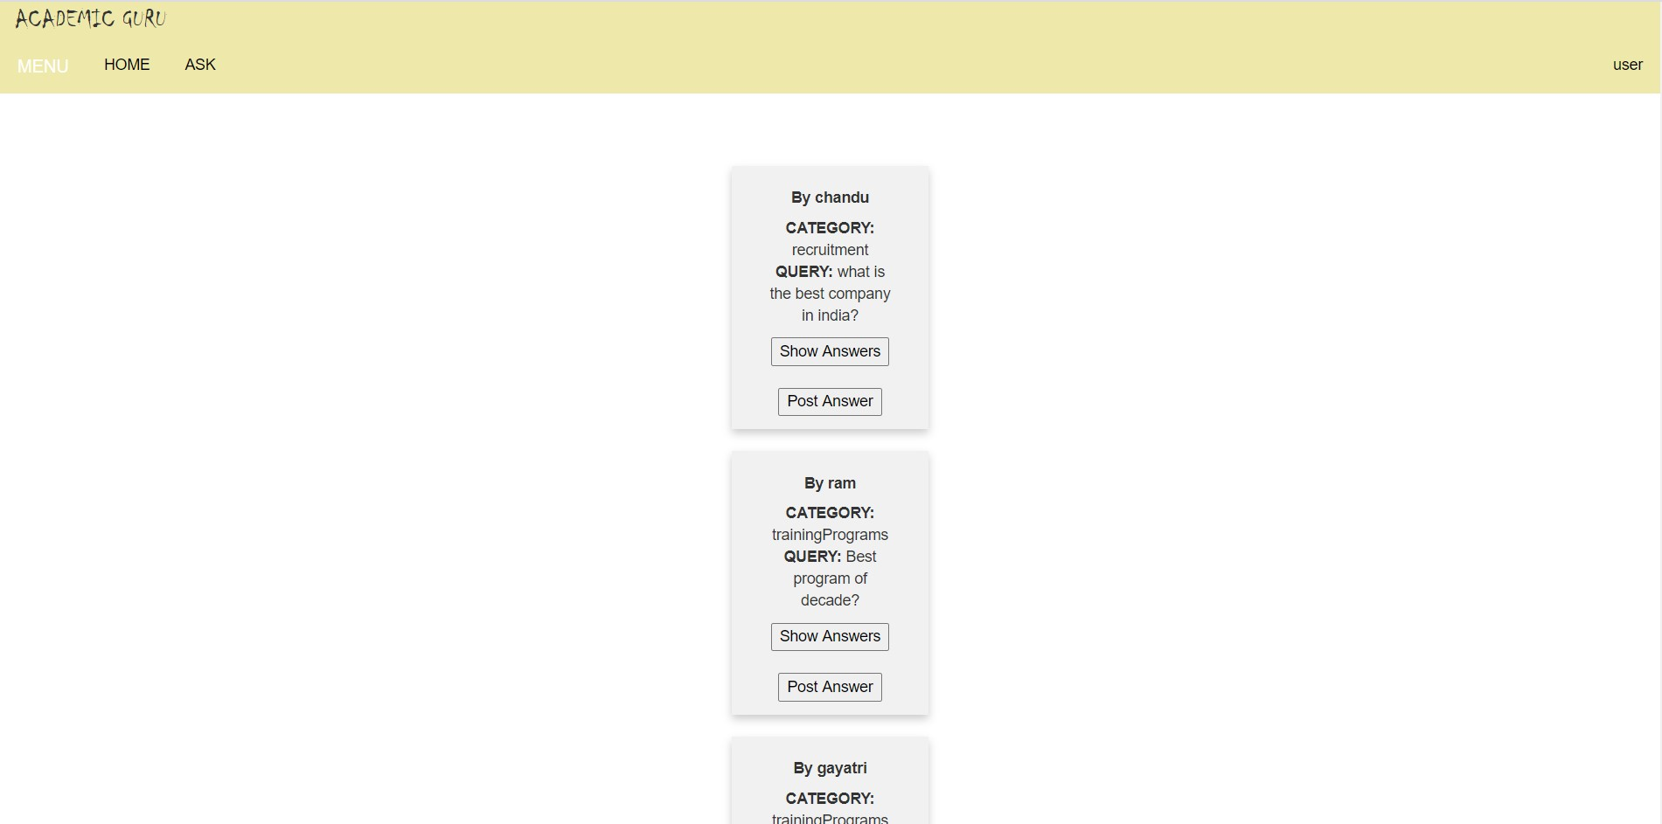
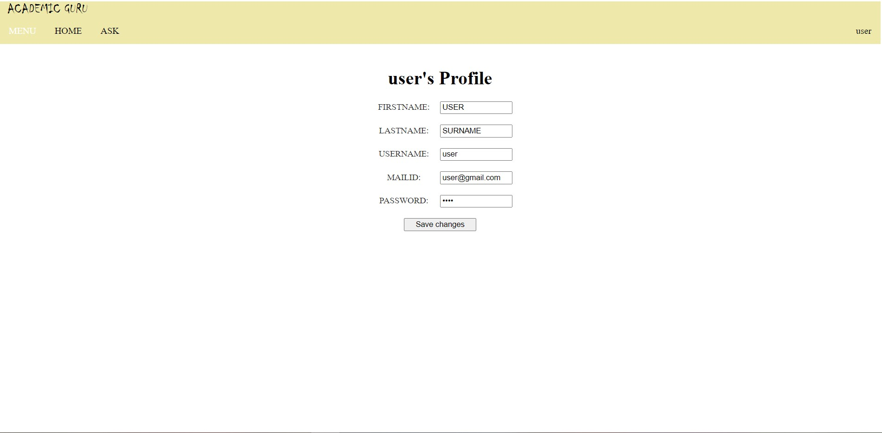
Output Screens
Home page
User’s Profile Page

Slide 12
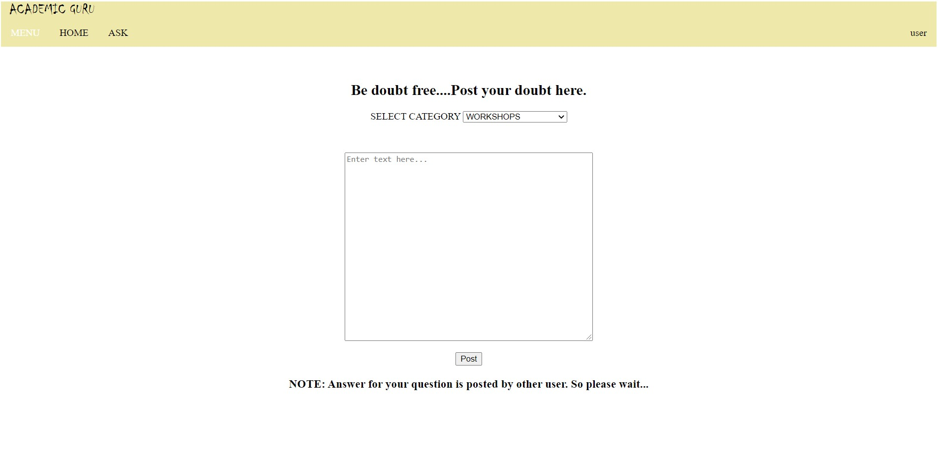
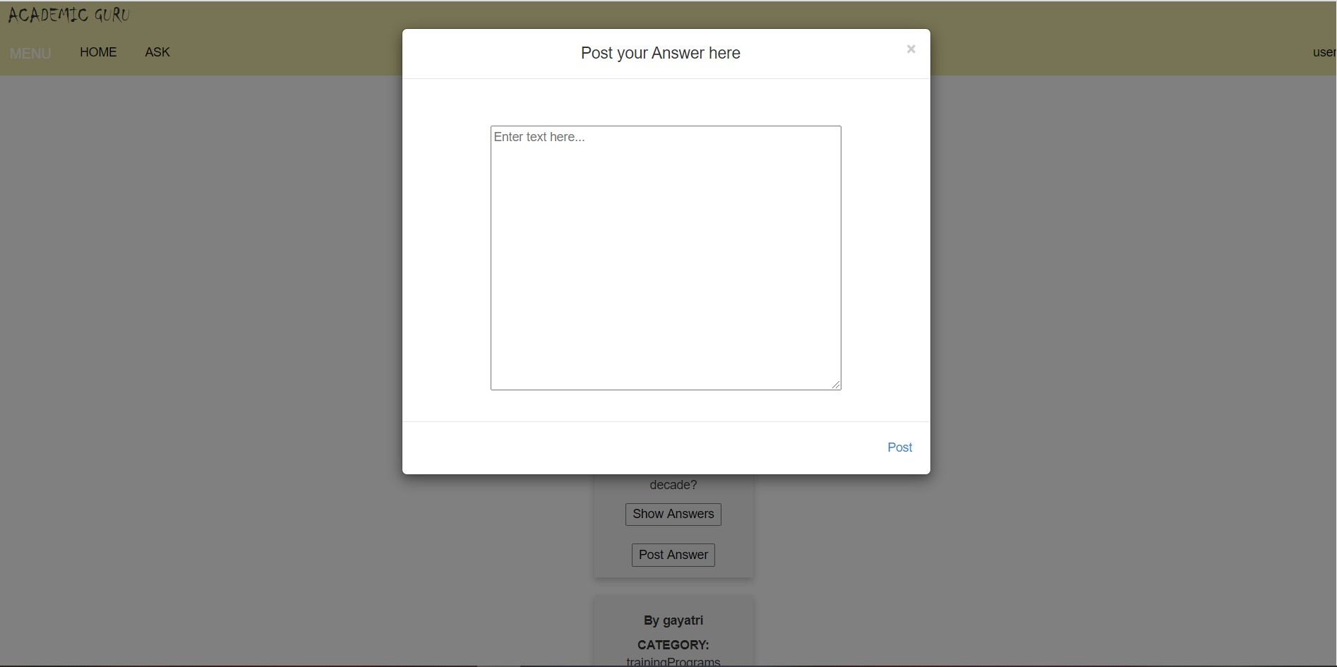
Output Screens
Ask page
Post Answer popup

Slide 13
Technologies Used
JDK 8
Advanced Java (Eclipse Neon)
JDBC(Java Database Connectivity)
CSS/Bootstrap/HTML
JSP(Java Server Pages)
MySQL

Slide 14
References
W3Schools
Stack overflow
Geeks for geeks
TutorialsPoint
JavatPoint

Slide 15
Thank You

